Slide 1

Group 2: Credit Card Approval Prediction
Cody Gardner
Bradley Barker
David Owens
Marie Prosper

Slide 2

Overview
To predict whether the credit card application will be accepted or rejected.
Show success predictor
Show failure predictor
Predicts the odds based on:
1- Number of Children
2- Income (USD)
3- Family Size
4- Gender
5- Own Car
6- Own Realty
Regression Model

Slide 3
Goal
To predict whether the credit card application will be accepted or rejected.
Show success predictor
Show failure predictor
Predicts the odds based on:
1- Number of Children
2- Income (USD)
3- Family Size
4- Gender
5- Own Car
6- Own Realty
Regression Model

Slide 4
Technologies
Python (Jupyter Notebook, Pandas, sklearn, matplotlib)
Flask
SQL/ Postgres DB
JavaScript Libraries (D3, Plotly, Leaflet)
HTML/ CSS (Bootstrap)
CSV
SQLAlchemy
Machine Learning

Slide 5
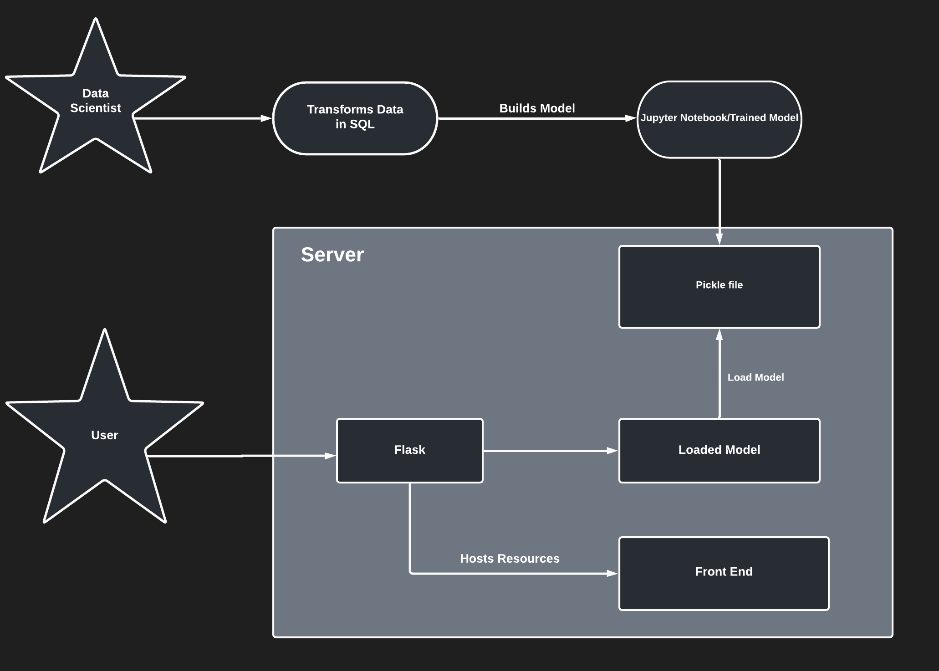
Credit Risk

Slide 6
Steps to Show Success Predictor Model
1. Data Cleaning
Removing extraneous columns
Null values
Duplicates
2. Merging datasets by grouping shows
3. Individual scatter plots for each feature
4. Regularization: Coefficient plots XXXX
5. Function to test the familiar Regressors
6. Scaling the data – XXXXX
7. Model Selection & Prediction
8. MSE & R-squared score: Lesson Learnt
9. Exported the model
10. Flask implementation

Slide 7
TEST 123

Slide 8
TEST 123

Slide 9
TEST 123

Slide 10
TEST 123

